Slide 1
Insights on Seoul Bike Sharing
Group – 1
Course Name: Data Analysis and Visualization
Course Code: CDS3006
Faculty Name: Dr. Irfan Alam

Slide 2
Group Members:
Harsh Kakaiya -------------------------------- 20MIP10007
Kallol Kanti Bera ----------------------------- 20MIP10009
Aditya Srivastava ---------------------------- 20MIP10037
Deepti Shakya --------------------------------- 20MIP10041

Slide 3
To find the highest number of bike rentals overall, follow the given steps;
Find which month has highest bike rent in the year 2018.
Find which day of the week in June had highest number of bike rent.
Find which Friday had most number of bikes rented.
Find at which time the bike was highly rented on 8th June 2018.

Slide 4
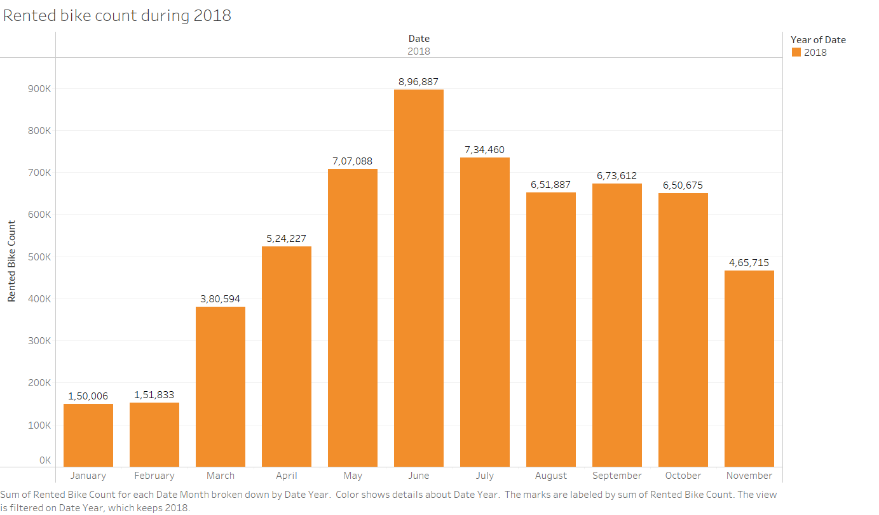
To find which month has highest bike rent in the year 2018
A bar chart could be considered as seen in figure.
The number of bikes rented is seasonal, with more bikes rented in the summer months and fewer bikes rented in the winter months.
There is a correlation between the number of bikes rented and the weather.
The month of June has the most bike rented with 8,96,887 numbers of bike rentals in the year 2018.

Slide 5
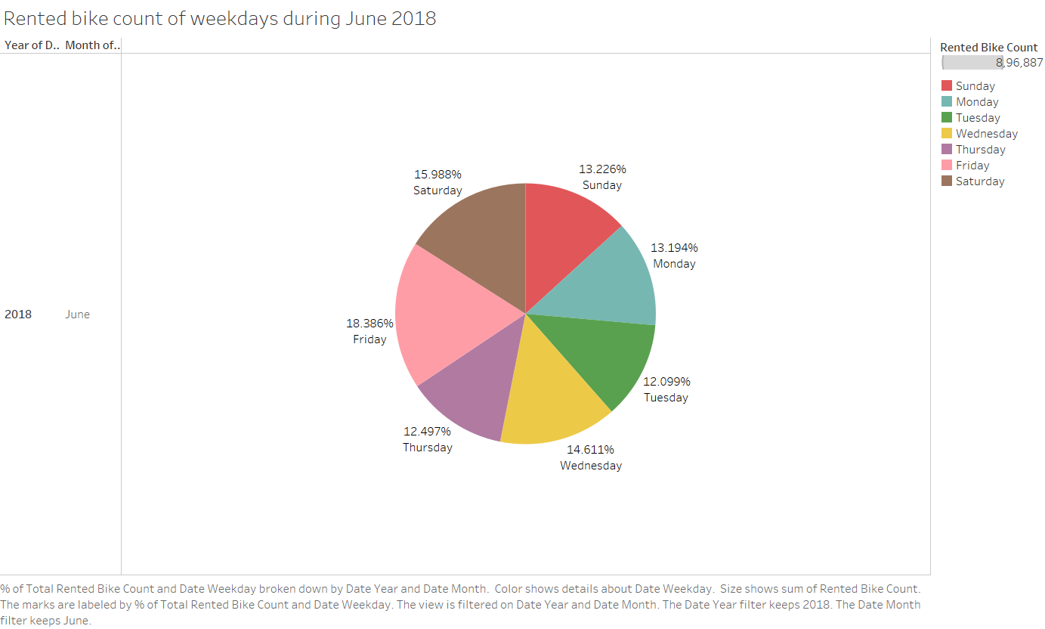
To find which day of the week in June had highest number of bike rent
The pie chart could be considered as seen in figure.
As seen in the pie chart, it is divided into different days of the week.
The highest percentage is Friday with 18.3%.

Slide 6
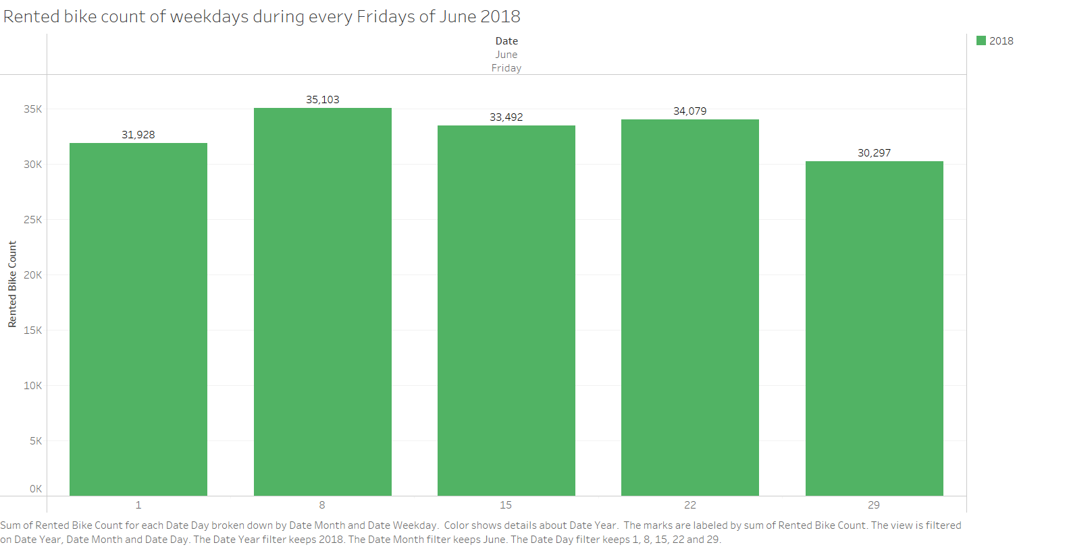
To find which Friday had most number of bikes rented
A bar chart could be considered as seen in figure.
Here, the dates of every Friday are taken which come under the month of June.
The highest number of bike rented is on 8th June 2018 with a rental of around 35,000.

Slide 7
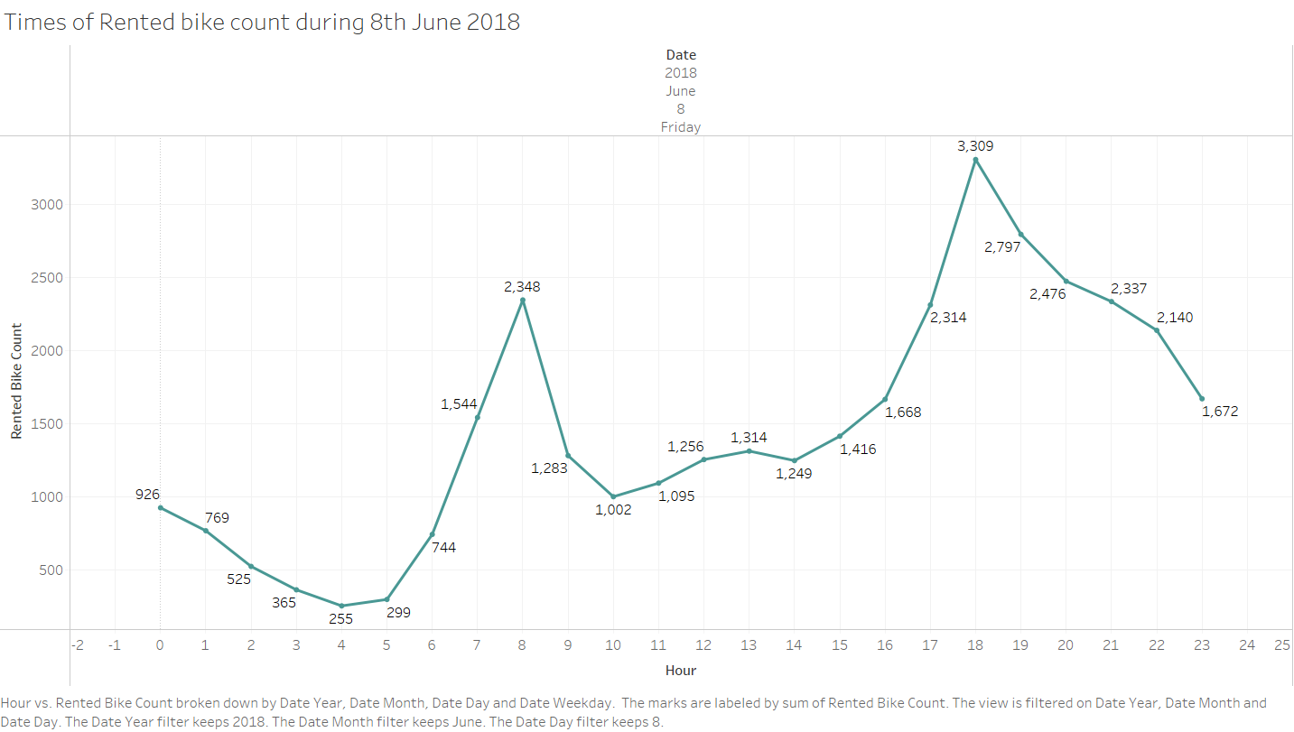
To find at which time the bike was highly rented on 8th June 2018
The line chart could be considered as seen in figure.
Now, we find the time at which the bike was rented highest on 8th June.
The highest number of rental was at 18.00hrs with a rental of around 3300 bikes.
This shows that people at Seoul might like to spend a ggo quality time at weekends.

Slide 8
Questions:
What is the trend of rented bike count over the months?
Which seasons show greater demand for the rented bike than other seasons?
Is the demand for rented bikes affected by the holiday season?
Is there a relationship between the rented bike demand and temperature?
Is there a relationship between the rented bike demand and the amount of rainfall?

Slide 9
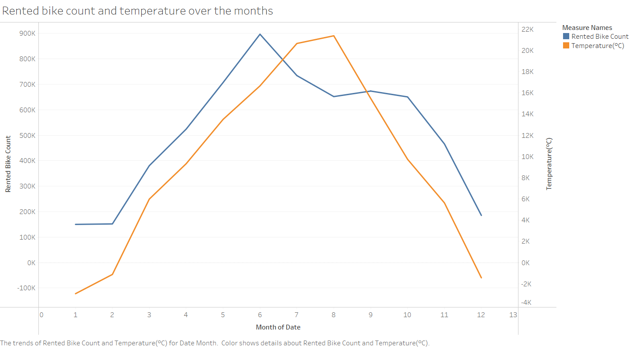
What is the trend of rented bike count over the months?
The line chart could be considered as seen in Figure.
It shows that there is a significant change in rented bike count over the months.
From February, the demand for the rented bike has continuously increased until June.
After that, the decreasing trend of the rented bike was shown.
This trend was similar to the trend of temperature over the months.

Slide 10
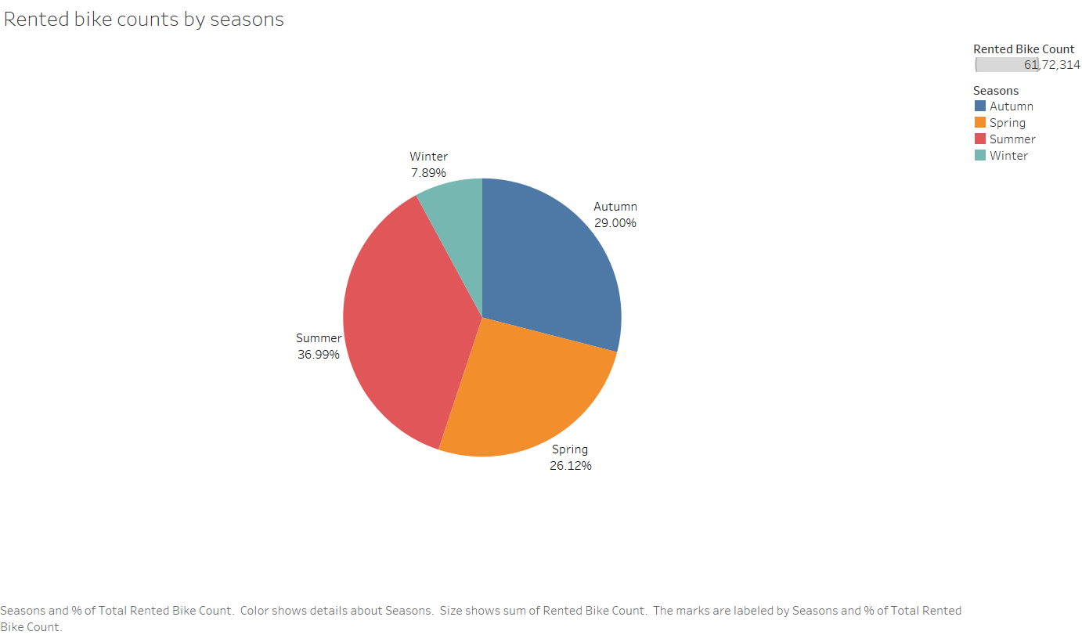
Which seasons show greater demand for rented bike than other seasons?
The pie chart could be considered as seen in figure.
The summer shows the highest demand for the rented bike (37%), followed by Autumn (29%).
As expected, Winter showed the lowest demand (7.9%).
It suggests that the supply of the rented bikes could be differently allocated by various seasons.

Slide 11
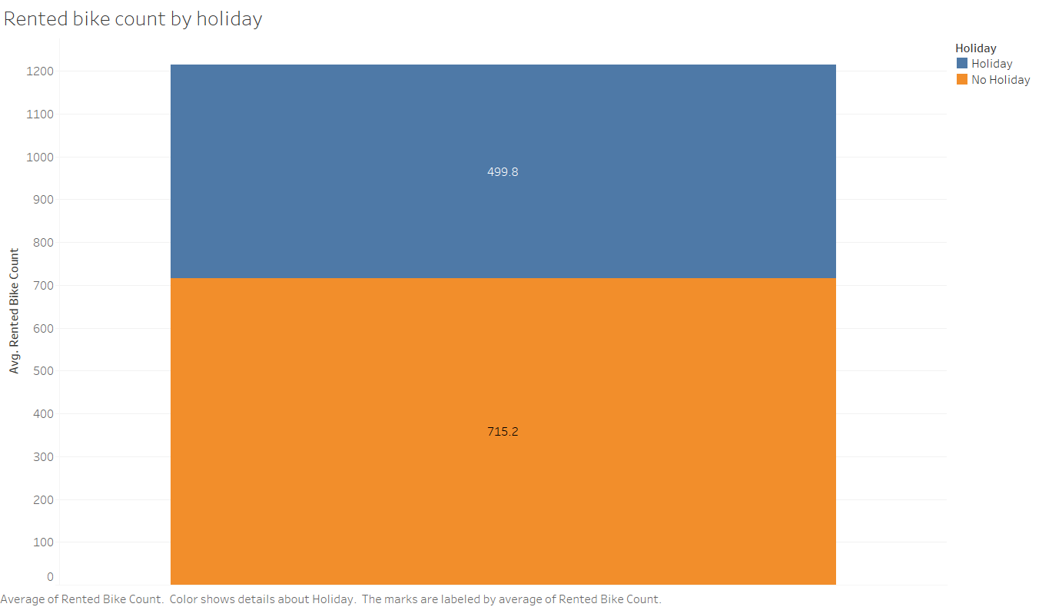
Is demand for rented bikes affected by a holiday season?
The stacked bar chart could be considered as seen in figure.
It shows that “no holiday” had a 1.4 times greater demand for the rented bike than a “holiday” season.
This suggests that some of the customers used rented bikes for their commute to jobs.

Slide 12
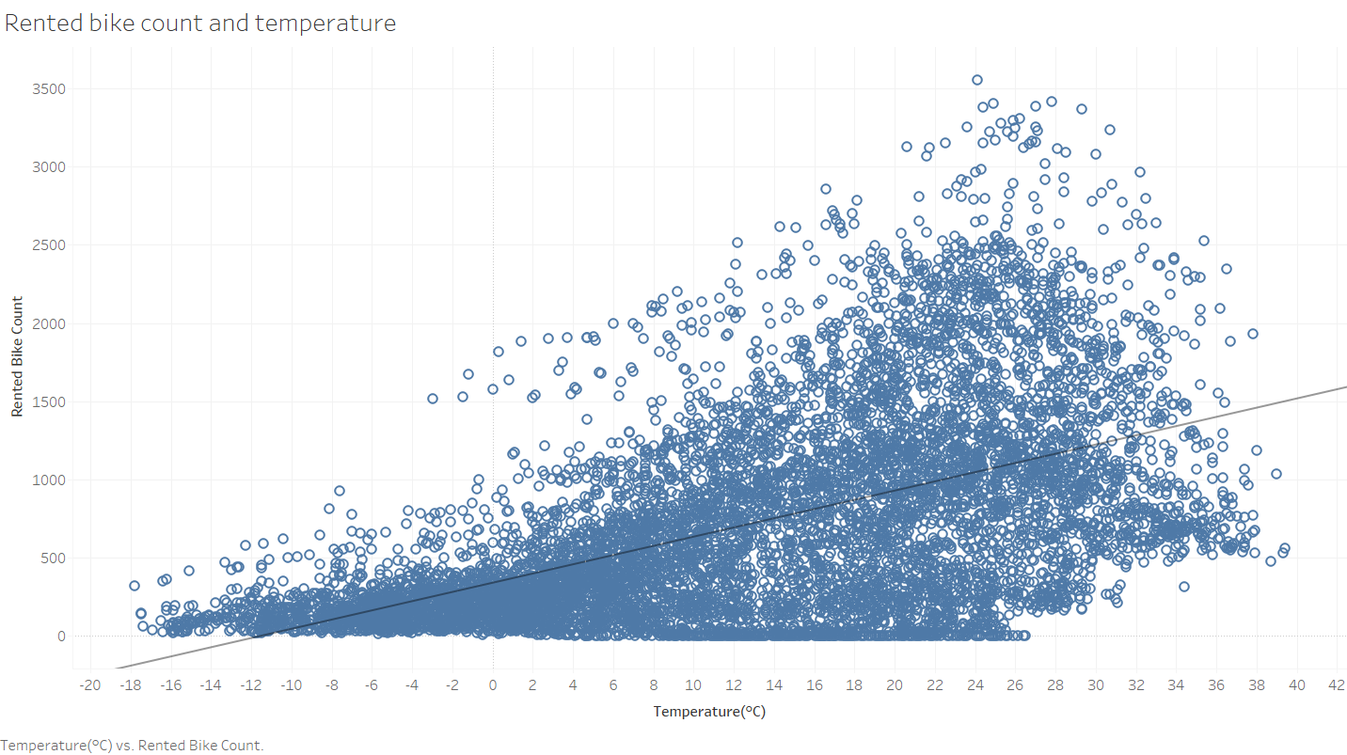
Is there a relationship between the rented bike demand and temperature?
The scatter plot could be considered as seen in figure.
It shows that a positive relationship existed between the rented bike count and the temperature.
As the temperature increased, the rented bike count tended to grow as well.
However, after around 25 °C, the rented bike count substantially decreased. This indicates that too high a temperature could reduce the demand for rented bikes.

Slide 13
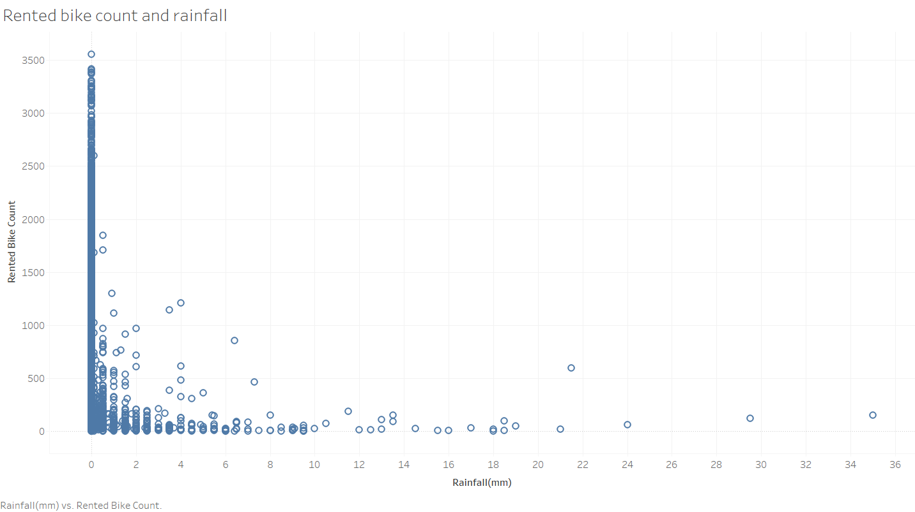
Is there a relationship between the rented bike demand and the amount of rainfall?
The scatter plot could be considered as seen in figure.
It shows that the greatest bike demand existed with no rainfall.
As the amount of rainfall increased, the demand for rented bike dramatically decreased as a nonlinear trend.
It suggests that the rainy weather condition is a critical factor affecting rented bike demand per day.

Slide 14
Thank You!

